Slide 1
Java Plays : Alchemy API Lab
IBM
ECOD

Slide 2
AGENDA
Purpose of This Lab
Pre-Requisites
Register for Alchemy API Key
Create a New Java Project
Add Alchemy API Dependency
Run AuthorTest Java Snippet
Run All AlchemyAPI Java Snippets
Java Plays : Alchemy API

Slide 3
Purpose of This Lab
In this lab, you will learn how to use the rich set of Cognitive Computing APIs
made available using Alchemy APIs.
Java Plays : Alchemy API

Slide 4
Pre-Requisite
Install Eclipse Mars
Install Java JDK 1.7
Java Plays : Alchemy API

Slide 5
Step 1: Register for API Key
Register for API Key at http://www.alchemyapi.com/api/register.html.
Check your email address for a key from AlchemyAPI.
You will replace the key shown below with your Alchemy API Key in each AlchemyAPI snippet.
Java Plays : Alchemy API

Slide 6
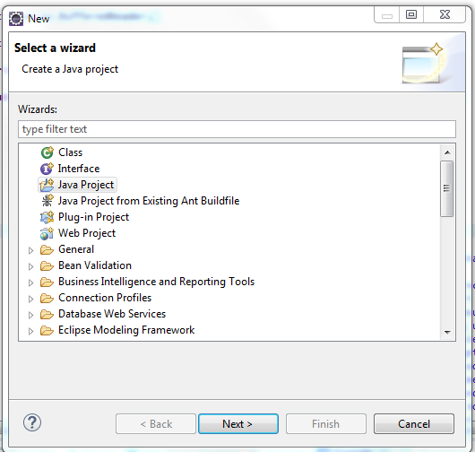
Step 2: Create a New Java Project
Open your local Eclipse pointing to your preferred workspace.
Click left upper top menu, File >> New >> Java Project.
Java Plays : Alchemy API

Slide 7
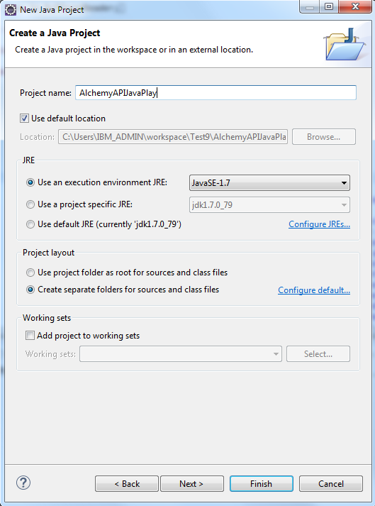
Click Next.
Name the project, AlchemyAPIJavaPlay.
Click Finish.
Java Plays : Alchemy API

Slide 8
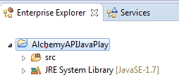
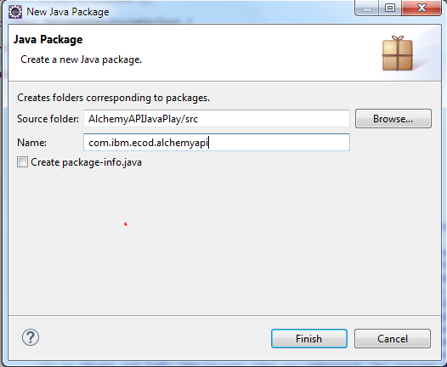
You have successfully created a lab project.
Right click on the project.
Select New >> Package.
Name the package as com.ibm.ecod.alchemy
Click Finish.
Java Plays : Alchemy API

Slide 9
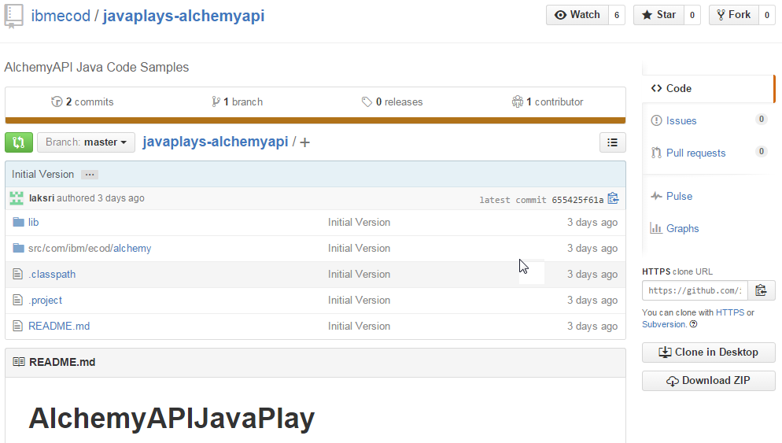
Step 3: Add Alchemy API Dependency
Go to AlchemyAPI GitHub repository at https://github.com/ibmecod/javaplays-alchemyapi
Click Download Zip.
Java Plays : Alchemy API

Slide 10
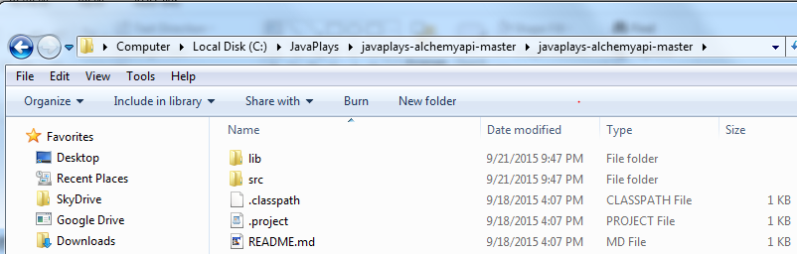
Unzip the downloaded file in your local folder.
Right click on your new Eclipse project >> Click Properties at the bottom.
Java Plays : Alchemy API

Slide 11
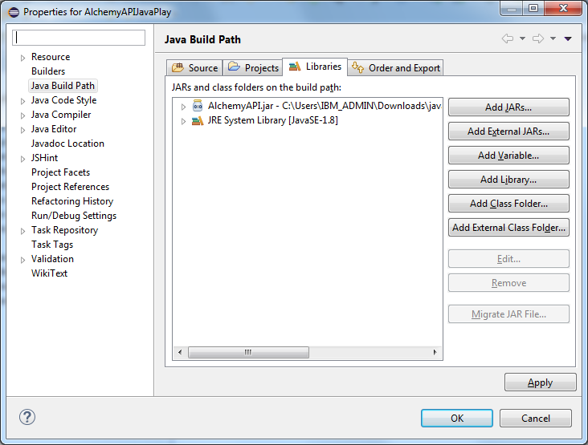
Select Java Build Path.
Click on Libraries tab >> Click Add External JARs.
Select AlchemyAPI.jar from your unzipped folder. e.g. \javaplays-alchemyapi-master\lib
Java Plays : Alchemy API

Slide 12
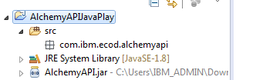
Click OK.
Now, you are ready to add code using Alchemy API.
Java Plays : Alchemy API

Slide 13


Step 4: Run Author Test Java Snippet
Double click each Java file to copy and paste the code into com.ibm.ecod.alchemy package you created in the new eclipse project, AlchemyAPIJavaPlay .
Replace the Alchemy API key on line 18 in AuthorTest.
Right click on the class.
Select Run As >> Java Application.
You will see the following result.
Java Plays : Alchemy API

Slide 14
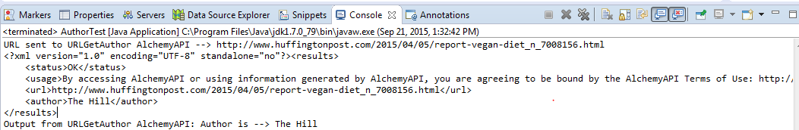
Replace the URL on line 20 with a URL of your choice and run the API snippet again.
Java Plays : Alchemy API

Slide 15


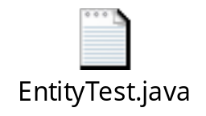








Step 5: Run All Alchemy Test Java Snippets
Repeat the same steps defined in step 4 to run each of the following Java Class files. No need to copy AlchemyUtility.java file again.
Java Plays : Alchemy API

Slide 16
This ends the Alchemy API Lab.
Thank you !
Java Plays : Alchemy API

